Slide 1
Speedball
Lakeshore Middle School
Physical Education

Slide 2
History of the Game
The game originated at the University of Michigan in 1921 as part of the men’s physical education and intramural classes
It’s creator, Elmer Mitchell, wanted to provide an athletic activity that all of his students could participate in regardless of their athletic experience or ability and was not restrictive by the rules of any one sport.

Slide 3
Overview of the Game
Speedball is a fast paced game that combines the elements of soccer, football, basketball and handball.
Two teams play speedball. A regulation team is made up of 11 players.
The ball is advanced by two methods: Dribbling or passing the ball down the field using the feet (as in soccer) or by catching a series of aerial balls thrown down the field from teammate to teammate in a fashion similar to handball
Can be played indoors on a basketball court or outdoors on a soccer/football field.

Slide 4
Scoring
Outdoor Game
Touchdown: (1 point) a goal is scored when an offensive player passes the ball to a teammate who catches it behind the opponents end line.
Field Goal: (2 points) a field goal is scored when the ball passes over the crossbar after being dropkicked from the field of play outside the penalty area.
Soccer Goal: (3 points) a goal is scored when a ball has been kicked into the goal.
Indoor Game
Touchdown: (1 point) a goal is scored when an offensive player passes the ball to a teammate who catches it behind the opponents end line.
Basket: (2 points) a basket is scored when an offensive player makes a basket from inside the key.
Soccer Goal: (3 points) a goal is scored when a ball has been kicked into the goal inside the 3 point line.

Slide 5
Outdoor Field

Slide 6
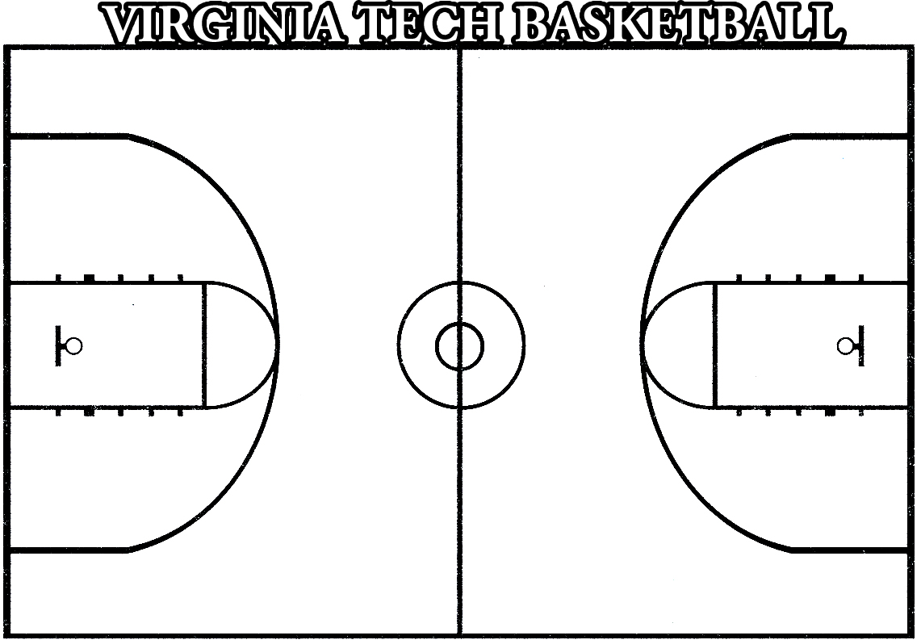
Indoor Court
End zone area – catch an aerial pass into end zone for 1 point
Key area – shoot a basket for 2 points
Goal kick area – kick a goal between cones for 3 points

Slide 7
Offensive Skills
Ground Ball: a ground ball is a ball that has fallen to or touched the ground and must be played with the feet. All soccer skills and rules apply to ground balls and should be used to move the ball down the field to score or set up an aerial ball to a teammate.
Aerial Ball: an aerial ball is one that has been lifted into the air from a lift or direct kick. An aerial ball that has been caught may be passed from one player to another as in basketball or football. An aerial ball can continue to be played in this manner until it again touches the ground, becoming a ground ball. A player catching an aerial ball while running is allowed only momentum steps to immediately stop. Once stopped, a player has a maximum of five seconds to pass or drop the ball to the ground.
Air Dribble: a play in which a player tosses the ball into the air to themselves. Player is limited to 2 air dribbles.

Slide 8
Defensive Skills
Position yourself between your opponent and the goal
Guarding player-to-player in aerial ball situations
Backing up teammates
Clearing the ball away from the goal to the outside
Close down aerial and ground passing lanes

Slide 9
Defensive Skills
Pass backwards to open up play
The goalie is responsible for stopping all shots on goal
Other players are responsible for stopping touchdowns and field goals/baskets
Goalie can punt the ball down field and pick it up off the ground.

Slide 10
Fouls
Tripping
Holding
Unnecessary roughness
Obstructing: preventing the progress of a player by personal contact
Touching a ground ball with the hands or arms
Traveling: shuffling your feet when holding the ball (like in basketball)
Dropkicking the ball within the penalty area.
Slide tackling
Hitting the ball out of an opponents hands

Slide 11
Outdoor Rules of the Game
The goalie may pick up the ball with the hands in the penalty box, may punt it, throw it or place kick it. Once the goalie has the ball he/she may not be interfered with.
When the ball is kicked over the end line by the offense the defense gets a goal kick as in soccer.
When the ball is kicked over the end line and touched last by the defense the offense gets a corner kick as in soccer.
If a player fouls another player that has possession of the ball, the offended team gets a free kick.
A free kick is a kick awarded to the offended team at the spot of the foul. You may score on a free kick. The kicker may only kick it once and the defense has to be 10 yards away. A foul such as pushing, blocking, dangerous kicking and hands results in a free kick.
The ball is put into play by a kick-off from the center to start the game or after each score.
The object of the game is to advance the ball down the field toward an opponent’s goal and attempt to score.

Slide 12
Indoor Rules of the Game
The goalie may pick up the ball with the hands in the key, throw it or place kick it. Once the goalie has the ball he/she may not be interfered with.
When the ball is kicked over the end line by the offense the defense gets a goal kick as in soccer.
When the ball is kicked over the end line and touched last by the defense the offense gets a free throw from the corner
If a player fouls another player that has possession of the ball, the offended team gets a free throw in (if foul occurred outside the 3 point line) or a free throw shot (if foul occurred inside the 3 point line).
A free throw in is a throw awarded to the offended team at the spot of the foul. Defense has to be 5 feet away. A free throw shot is a shot from the free throw line. Counts as two points. Ball is live as soon as it hits the rim. A foul such as pushing, blocking, dangerous kicking and hands results in a free kick.
The ball is put into play by a jump ball at center court to start the game. After each score the ball is passed in from behind the baseline.
The object of the game is to advance the ball down the court toward an opponent’s goals and attempt to score.

Slide 13
Vocabulary
Punt – a play in which a player drops a caught ball and meets the descending ball with the foot before it touches the ground
Pivot – a play in which a player who is holding the ball steps once, or more than once, in any direction with the same foot. The pivot foot must keep the initial contact with the ground.
Foul – an infringement of the rules of the game for which a free kick, free throw or penalty kick is awarded the opponents.
Drop Kick – a ball that is dropped bounces once and is kicked into the air. Used to score when playing with field goals.
Save – when the goalie plays the ball and prevents it from going into the goal

Slide 14
Vocabulary
Dribbling – a series of short, controlled kicks made with the inside or outside of the foot
Traveling – a player runs with the ball without passing
Trapping – stopping the progress of the ball with the foot or leg
Throw In – when a player restarts play be throwing the ball into play after it has crossed a side line. A throw in can be made by any player.
Kick-up – a means of converting a ground ball into an aerial ball

